Slide 1
Potential Regeneration Images

Slide 2

The Trajectory of Regenerating Plant Cells
Kenneth Birnbaum
New York University
Santa Cruz Developmental Biology Meeting

Slide 3
Radial Anatomy
Xylem
Phloem
Stele
Pericycle
Endodermis
Cortex
Stem Cell Niche
Epidermis
More Mature Cell
Columella
Stem Cell (Initial)
Quiescent Center

Slide 4
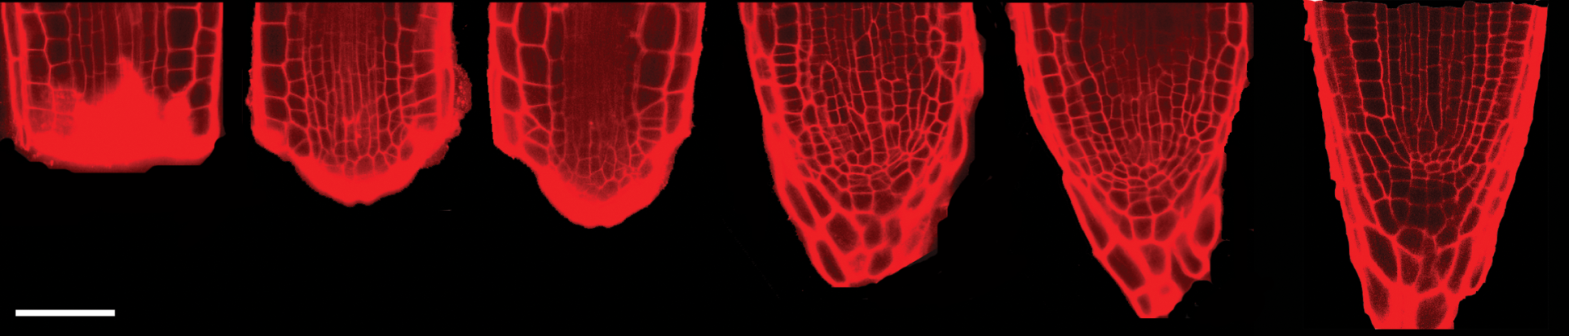
Root Tip Regeneration
time
0 day
1 day
2 days
3 days
4 days
5 days
cut
1 dpc
2 dpc
3 dpc
4 dpc
5 dpc
50 μm
50 μm
dpc = days post-cut
Notes:
4
This is a median optical section of the root tip, counterstained with PI and visualized with confocal microscopy.
When I manually cut-off the tip at a distance of about 70um, right above the stem cell niche, in a matter of days the tip regenerates.
It was important to show that A. root could indeed be used for studying de novo organ regenration
It’s important to realize that this plants are germinated, grown and regenerated on standard solid medium, in absence of hormones or exogenous signalling molecules.
Each day the plant is removed from the incubator, mounted on a slide with the counterstain, and imaged. Then, it is transferred back to the incubator.
In this set of time-lapse images, taken one every day after the cut off, we can appreciate the morphological changes, both at the macroscopic level with the reappearance of the overall conical shape, and at the cellular level looking at the geometrical pattern being re-established.
Morphology is one aspect. A second important aspect is the re-establishment of cell fate

Slide 5
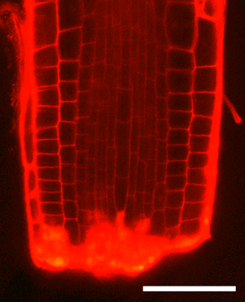
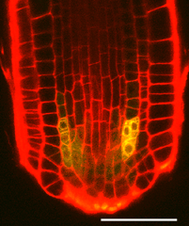
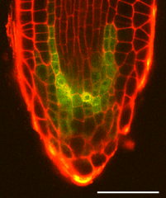
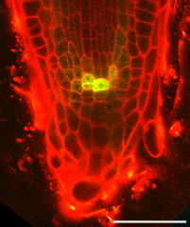
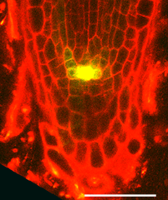
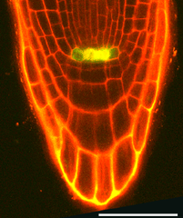
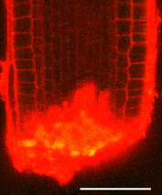
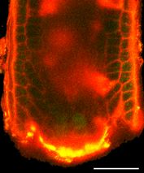
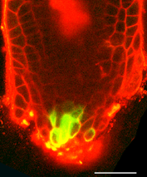
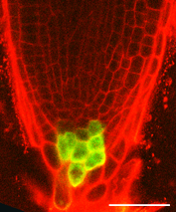
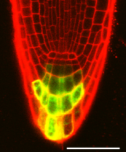
Cell type re-establishment
QC – Stem Cell Niche
WOX5::GFP
WOX5::GFP
PET111
PET 111
uncut
cut
1 dpc
2 dpc
3 dpc
4 dpc
Root Cap – Differentiated Cell
1 day
2 days
dpc = days post-cut
bar = 50 μm
Sena et al., 2009
0 day
3 days
4 days
Notes:
To address the reappearance of lost cell types,
We visualized the change of spatial expression pattern of a panel of fate-specific fluorescent reporters.
On the top is a gene expressed in the QC cells, on the bottom an enhancer trap showing expression in the columella.
Don’t be confused by the yellow artifact (saturation on the red channel).
It is important to notice that cells that were not expressing wox5 before the cut, started to express it one day in the regeneration. Later, the pattern broadens up before refining itself to the original one.
The second fate remains more localized at the tip, resembling very quickly the original patter.
Both are examples of re-patterning at the single-gene levels.
What you really would like to do, is to have not just one cell type marker, but a set of them for each fate

Slide 6
Fate Transformation
Transdifferentiation
Stele Cell
Columella
?
Microscopy
Cell type and single cell transcriptomics
QC
Dedifferentiation
Niche Reestablishment

Slide 7
Potential Algae Images

Slide 8

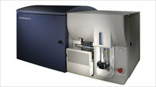
Experimental evolution on lipid content using fluorescence-based selection
Ken Birnbaum
Center for Genomics and Systems Biology
New York University
Keith Arora-Williams

Slide 9
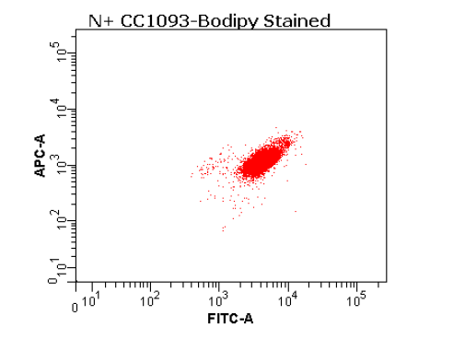
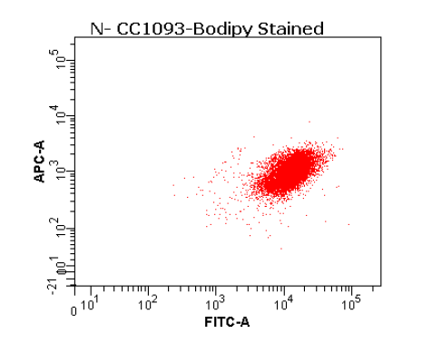
High throughput examination
Chlorophyll
Fluoresence
BODIPY 505/515 Fluorescence
Notes:
2 Days after resuspension in N-Free Media versus in N replete media
Area-Normalized Metrics
We use Fluorescence Activated Cell Sorting (FACS) as a screening and selection tool to evolve a population that produces high oil body content in absence of nitrogen starvation.

Slide 10
Filtering and Sorting Criterion
Size filtering
Filtering on chlorophyll
fluorescence emission
Sorting from a gate that
controls for plastid size bias
Control population sorted
from center of distribution
Notes:
This was taken before sorting control population for during the second round of screening….

Slide 11
Decoupling TAG Accumulation from Nitrogen Starvation with Adaptive Laboratory Evolution
Notes:
Iterative process is a rapid method of domesticating this microbial fuel source

Slide 12
Preliminary Results
initial
selected
Distinct subpopulation segregating from distribution observed in controls
Appeared in 4 of 8 biological replicate cultures
Selected phenotype appeared at frequency 0.5 – 3.5 % in the positive replicates
Notes:
After 1 Round of Screening and Growth, we begin to see these two subpopulation emerge, distinct from controls and distinct from one another, during the second round of screening.

Slide 13
Potential Selaginella Images

Slide 14
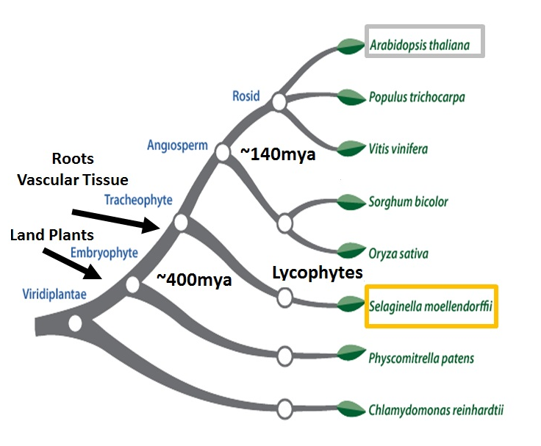
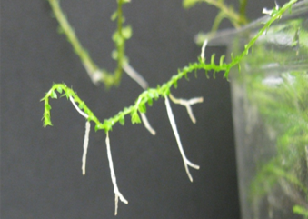
Project I: Development of a Molecular and Genomic Toolkit for the Examination of Root Development in Selaginella moellendorffii

Slide 15
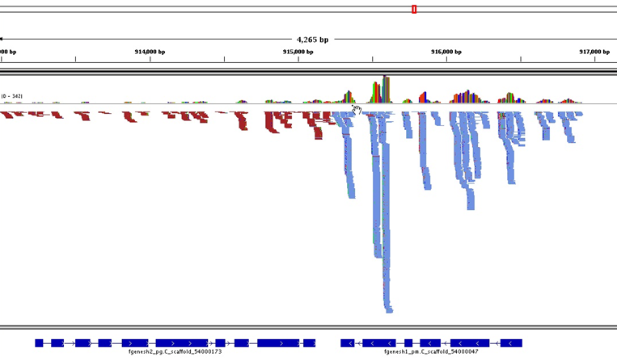
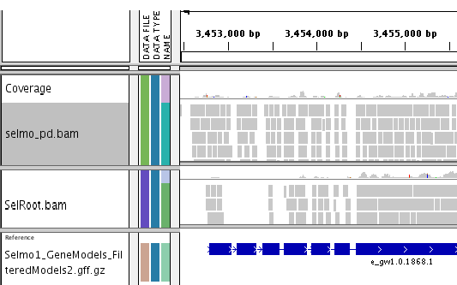
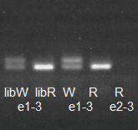
Part II: Molecular Techniques
Generation of Whole Plant and Root Transcriptomes Using SOLiD
Good coverage, gene-level resolution
(with Mitzi Morris)
Good resource, provided confidence to do tissue specific assays…..
Notes:
And to ensure the sequencing could be done at all, we used the available SOLiD platform to generate a whole plant and whole root transcriptome. We were able to get good coverage over the genome, resolve the appropraite intron/exon structures and even resolve from differences at the individual gene level, like cases of tissue-specific alternative splicing: here coverage of this exon in the whole plant sample, but not the root.
This whole plant data gave us an additional level of genomic resolution, and the confidence to try to do some tissue-specific profilinf

Slide 16
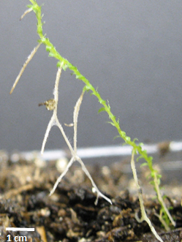
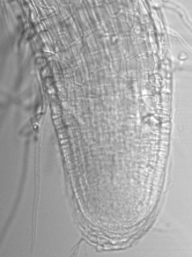
C. Generation of RNAseq Libraries from Low Input Root and Shoot Meristem Samples Motivation: What are the transcriptional identities of root/shoot organs in Selaginella? Setup: Generation of transcriptional profiless of root/shoot organs at key developmental stages
Shoot
Meristem Excision
Early
Rhizophore
(EZ)
Dorsal
NexGen
Sequencing
Rhizophore-Root (Z)
Root
Notes:
And the biological motivation for this work, in brief, is that Selaginella belong to a family of plants thought have to have the first true root and vasculatue. When we look at root development in this plant- it’s different- the majority of roots are shoot borne and they go through this intermediate phase called the rhizophore. So to get a better idea of the moelaulr identities of these root shoot organs, I collected the different root/shoot organs at key developmental stage and generated RNA libraries for expression level comparisions.

Slide 17
Development of a Molecular and Genomic Toolkit for the Examination of Root Development in Selaginella moellendorffii
Notes:
Ok, so how about the Selaginella work? Well over the past year, I’ve worked on resolving a lot of the sequencing-realted issues that came up at our last meeting, and I like to talk a little bit now about how plan to refine the project and briefly give you appropraite context for that focused body of work.
So just as a reminder, why Selaginella?
Ok, so we know that land plants are pretty essential, right, but when it comes down to it, we don’t know all that much about the origin and evolution of some of the key structures that really facilitated their transition and radiaton on land some 450mya. One of those key structures is the root, a distinct organ anchors and transports nutrients to the plant body.

Slide 18
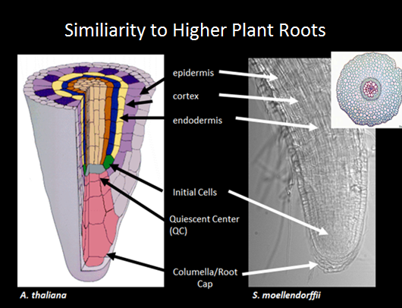
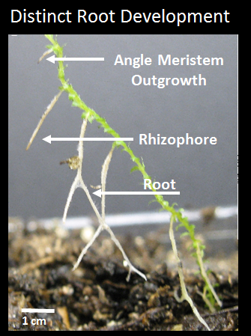
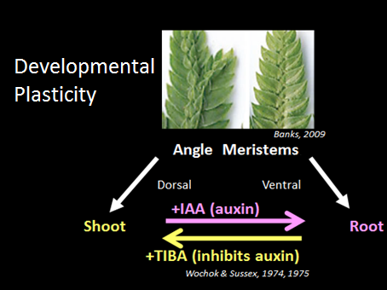
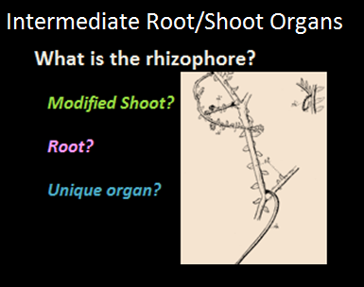
System is poised to address longstanding questions in early land plant root development and evolution…
Interesting features:

Slide 19
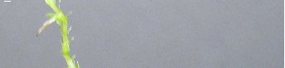
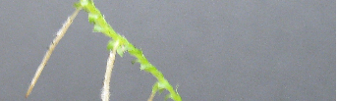
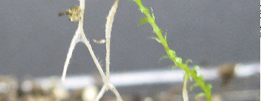
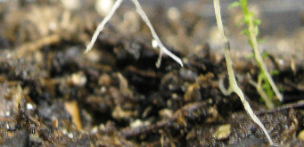
Chapter 5: Characterization of Major Root Developmental Features in S. moellendorffii
Does the sequenced modelS. moellendorffii
share the same developmental features
that have made Selaginella a system of
interest?
Result I :
Distinct developmental timeline,
but shared key features
-shoot-borne roots
-expansion by bifurcation
-intermediate structure (rhizophore)
Angle Meristem Outgrowth
Rhizophore
Root
1 cm
S. moellendorffii
Notes:
The first thing I did was characterize root development in the sequenced species, which was particularly important to do if is to be used this plant for the intended molecular studies Without going into too much detail, I established methods for propagation of S. moellendorffii roots in the laboratory and observed that root development in these plants is with consistent with the classic evolution studies done in other species (shoot- borne roots, dorsal and ventral angle meristems giving rise to shoot and root fates, respectively).

